Slide 1

Basics of Neural Network Programming
Derivatives
deeplearning.ai

Slide 2


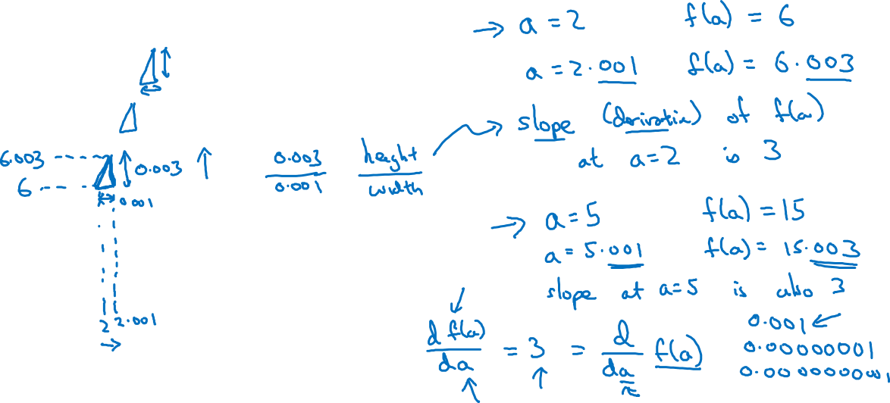
Intuition about derivatives
$$f\left(a\right)=3a$$
$$a$$

Slide 3
Basics of Neural Network Programming
More derivatives examples
deeplearning.ai

Slide 4


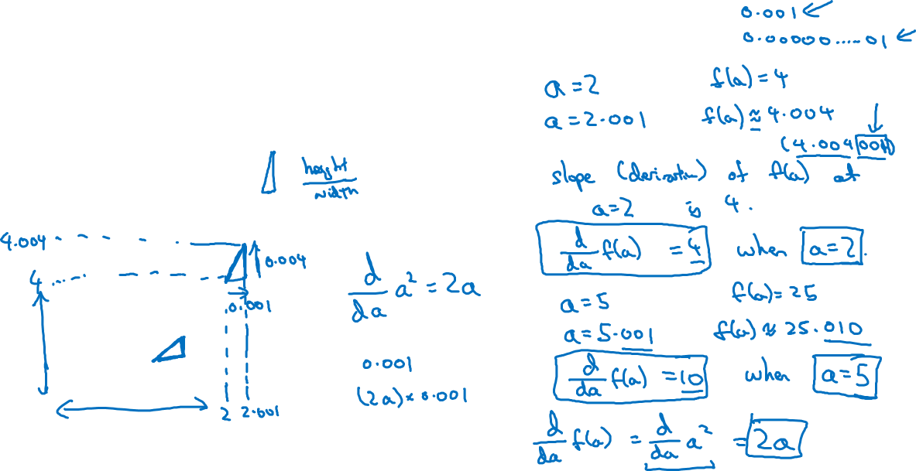
Intuition about derivatives
$$f\left(a\right)=a^{2}$$
$$a$$

Slide 5
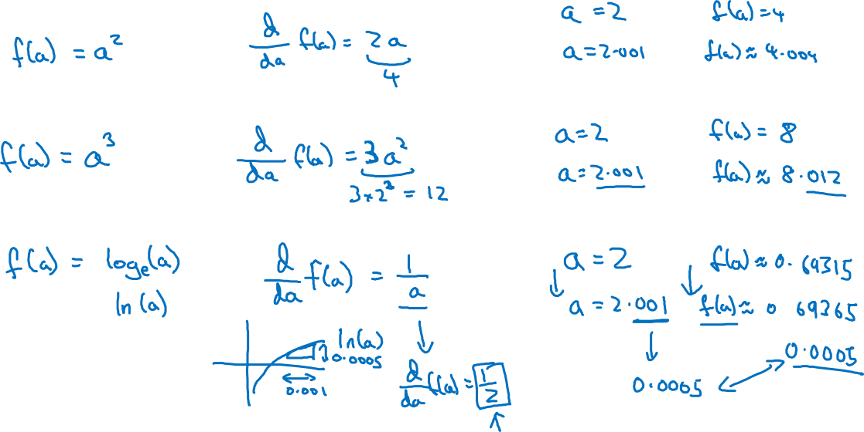
More derivative examples

